Slide 1
Building a social brand
Anna Slingo
@metoffice

Slide 2
Our channels
232,000 followers on @metoffice
Over 462,000 followers across all feeds
19 regional severe weather warning channels
9500 subcribers
2.5 million views
127,000 followers
Over 72,000 likes
Over 682,000 people follow us
across all platforms
Notes:
Our channels

Slide 3
A social journey - Five years to build a community
Listen
Talk
Engage
Sustain
What are people saying about you?
Introduce yourself & say something
Be useful
Target influential audiences
Develop meaningful two-way conversations
Engage with supporters and critics
Create content that people will want to share
Move followers to advocates; speaking on your behalf
Maintain two-way dialogue
What are people talking about?
Where is your audience likely to be?
Make a commitment with appropriate resources
Social listening; followers as weather observers
Notes:
Our social journey

Slide 4
Creating a 24/7 Twitter desk
Eyjafjallajökull volcanic ash event of April 2010 indicated a need for a 24/7 Twitter desk
Customer service team deal with questions 24/7, Comms team deal with proactive engagement
Shared Hootsuite account allows for monitoring of questions/mentions of @metoffice and ‘metoffice’
Training provided and tone of voice guidelines written
Weekly reports provided on performance and rooms for improvement

Slide 5
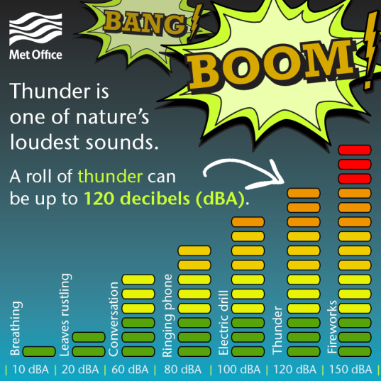
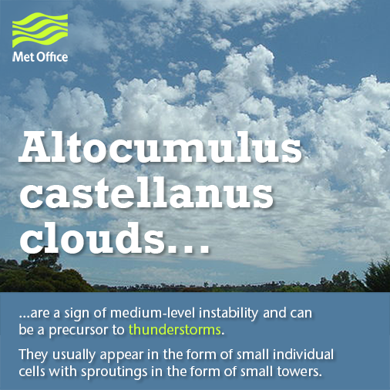
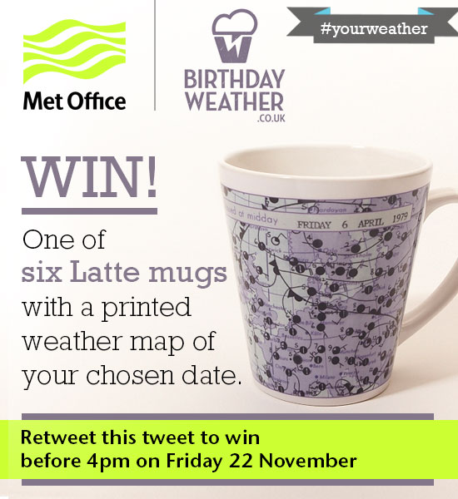
Managing our online presence
Social media manager deals with day-to-day proactive engagement
Daily weather briefings on latest forecast and possible issues
Social planning; daily, weekly, seasonally
Engaging our audience during periods of quieter weather – competitions, weather facts, weather explainers

Slide 6
Social strategy Continuous process of social listening and adapting
Early strategy Social listening (who is our audience?)
Defining our role Sharing the weather when it matters
Maintaining our audience How can we engage outside of periods of severe weather?

Slide 7
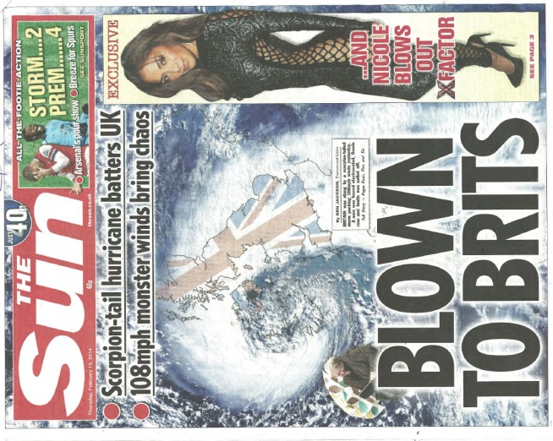
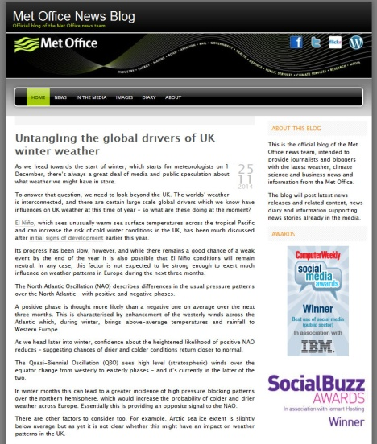
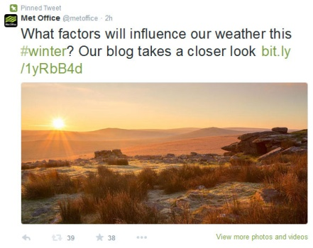
Challenges How can we control the messaging about severe weather?
Bad weather sells papers!
How can we manage the message?
Reactive – issuing blogs to address the headlines
Proactive – tackling the story before it happens
Sharing across social media channels

Slide 8
Social analysis Analysing, reporting, improving
Why are we using social media? What are our goals?
Is our information getting out there?
How could we improve?
Who are our competitors? What are they saying? What can we learn?
What channels are seeing peaks in engagement? How can we develop these channels? Which channels are not performing well?

Slide 9
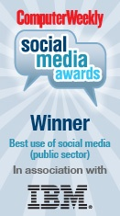
External recognition

Slide 10
Thank you
any questions?

